Slide 1

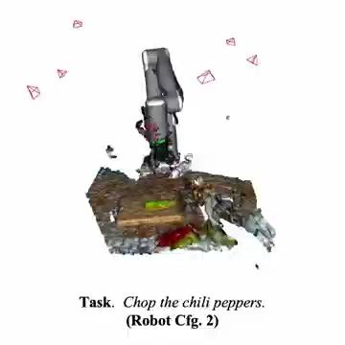

Enhancing Robotic Task Prediction with Multi-Modal Inputs:
Integrating Voice Commands and Mechanical Measurements
Will Li, Robotic Learning Fall 2024

Slide 2
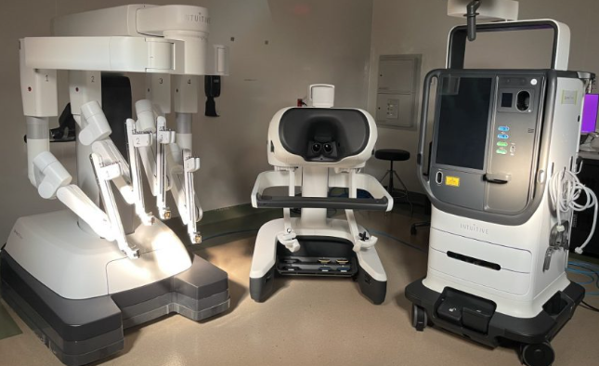
Background and Motivation
Conventional, mechanical based robotic control
High precision
Limitation: complex interface, accessibility
Multi-modal input
Flexible, intuitive
Question: Is it possible for multi-modal input to achieve comparable task performances

Slide 3
Methods
Problem contextualization
How much information is needed for robots to ‘learn’ what kind of task is performed?
Predict task category based on input variables
Experimental conditions
Rich Mechanical Input vs. Reduced Mechanical Input vs. Reduced Mechanical Input + Multimodal Input
Compare task classification accuracies
Hypothesis: Reduced mechanical input can be compensated by multi-modal input

Slide 4
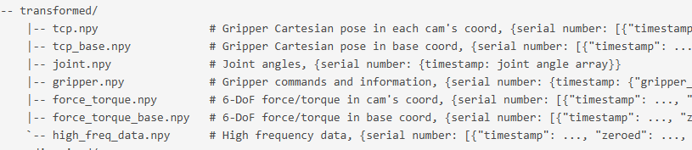
Dataset & Data Preprocessing
RH20T
Detailed robotic manipulation time-series data
Over 200 different tasks
Three models compared:
Baseline – original mechanical input
Reduced mechanical input – low-pass filtered
Multimodal – augmented with voice command embeddings.
1D CNN classifier to predict task category

Slide 5
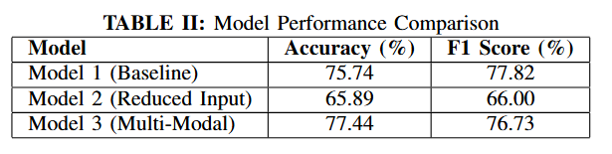
Results
Model Performances
Statistical Significance with Paired t-test:
Multi-Modal classifier outperforms Reduced Input classifier significantly.
Comparable to baseline model

Slide 6
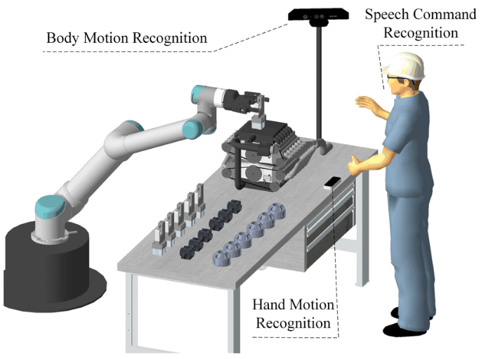
Discussion
Key takeaway:
Voice commands as effective alternative modality in robotic control
Multi-modal input can
reduce reliance on precise mechanical measurements
while achieve comparable accuracy
Future Work
Incorporate real-time human voice commands
Explore additional modalities

Slide 7
Thank you!

